Slide 1
Excalibur Project
digital infection chain detection & notification
Lead Author: Lars Engelhard, 18.01.2020

Slide 2
UNLEASH FUTURE® Lars Holger Engelhard - „The Brain & Polymath“
Lars Holger Engelhard is highly gifted and recognized international cross-industry expert. He is listed among the top 100 experts in the world.
Co-Founder of Unleash Future®, an international Think Tank of Highly Gifted People.
Performing in industries simultaneously: Medicine, Health, Pharma, Automotive, Consumer Products, Cyber Security, Defense and international Politics
Building the first Asian automotive online service in less than 3 months on pre-existing hardware not designed for this purpose.
Responsible for connecting millions of cars per year, outperforming global players like IBM, HP and T-Systems.
Lars’ core passion lies in technology and the fusion of the diverse knowledge fields.
2015 - present
CEO and Co-Founder of Unleash Future® International Think Tank of Highly Gifted People and Center of Excellence
Co-Author of the book ‘Come On’ of the international Club of Rome
Engineering Office Lars Holger Engelhard Strategic Advisor and Cross-Industry Expert
AUDI AG Director of In-Car and IT-Backend - Connected Car of VW Group
2015
2004 - present
2010 - 2014

Slide 3
IT ALWAYS SEEMS IMPOSSIBLE UNTIL IT'S DONE
Nelson Mandela

Slide 4
UNLEASH FUTURE® International Think Tank Of Highly Gifted People
Unleash Future®: an international ‘Center of Excellence’
Extremely gifted and talented people around the world joined to form this extraordinary Think Tank.
Our diversified teams provide ground- breaking solutions, strategies and tactics. In our fast-paced and complex world we transform fiction into innovation.
We significantly expand your knowledge base. Our cross-industry experience provides the perfect base for defining novel ideas and bringing innovation to life.
Unleash Future® keeps pushing frontiers to make disruptive innovations happen.
Everything is possible!

Slide 5
GLOBAL PANDEMIC

Slide 6
CHALLENGE – COVID19 Exponential Growth Quickly Pushes Capacities To The Limit
The most significant challenges:
Capacity of medical facilities, institutes and processes
Fact based decision making facing uncertainty
Investigative infection chain analysis & response times
Globalization
Emerging Technologies can
address many challenges
While pandemics operate globally, processes and solutions differ nationally, sometimes even regionally. This needs to change!

Slide 7
CHALLENGE – COVID19 Problems Of Current Status – Cloud & Platform Solutions
Today many Pandemic-Apps are arising. Problems:
Platforms are country specific solutions
Growing distrust in 3rd party & intermediaries
Limitations on global solutions because of local regulations like GDPR, CCPA and US Cloud Act
Operating large data centers is cost intense
Global centralistic solutions are prime targets because they contain valued data of many users
Current solutions are regional. Fighting a global pandemic as a global community becomes impossible!
Platforms put peoples records on risk!

Slide 8
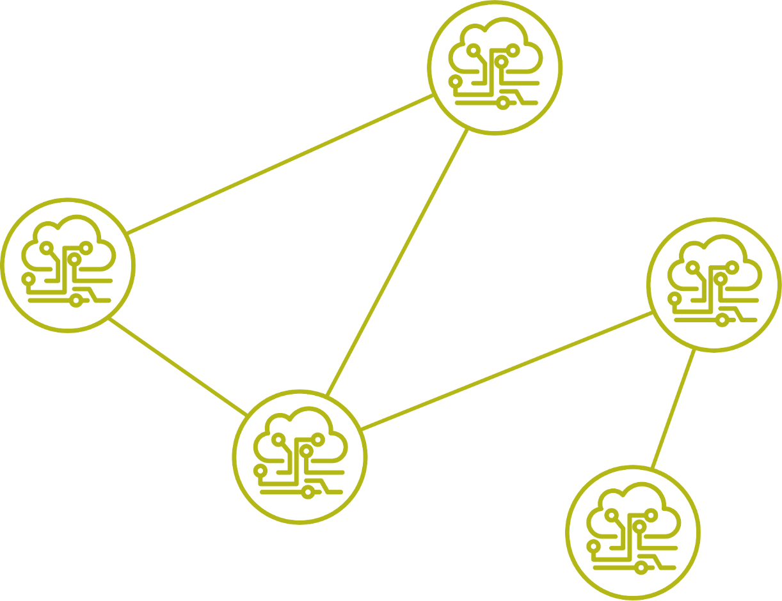
DECENTRALIZED SOLUTION Excalibur – Decentralized Global Response
Detection of proximity and contact time with infected people!
No data transmission to centralized data centers or clouds
Use short-range radio technology (e.g. Bluetooth ultra low power)
User identification (ID) is anonymized
Own data and data of contacted people are stored on the personal device
Data processing and analysis on the personal device
IDs of infected people are distributed to the network
Indication of individual risk-level, exposure level and exposure time presented to the individual
Trigger individual actions
8

Slide 9
DECENTRALIZED SOLUTION Empowerment, Trust, Community And Collaboration
Core conditions for a fast & global response:
Need of a solution by sense of urgency
Global solution respecting or agnostic to GDPR, CCPA, US Cloud Act and other regulations
Decentralized architecture for data, processing and analysis
Interoperability
Future proofed responsive technology – mitigating prospective epidemics and pandemics
Tracking and mapping of mutations of Virus (COVID19)
Data format and mechanism of contact detection must be published to ensure interoperability globally
Initiate a paradigm shift to spark a global response

Slide 10
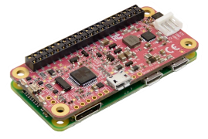
DECENTRALIZED SOLUTION Three Stages Of Deployment - Fast-track solution
First stage – Reference Device
Core-development of a reference device to ensure interoperability
“Golden Device” is reference
Specification of core functionalities:
ID calculation
Communication stack
Architectures
Protocols
Calculation algorithms
Local storage of data
Second stage – Pandemic-APPs
Open source development for Smartphone Apps
National solutions possible
>75% penetration in Europe possible
Parallel implementations to support
Various vendors
Various operating systems
Interoperability ensured by test-implementation in reference with the “Golden Device”
Third stage – Small electronic device
Excalibur device as a global response
Pocket sized, rugged, low cost solution
100% penetration
Adds devices for locations like buildings & transportations to the corona network
Global bail-out technology to fight epidemics and pandemics in the long-term - globally
Available for poor infrastructure regions providing equal access

Slide 11
DECENTRALIZED SOLUTION Small Electronic Device
45% demand relief for schools and kindergarten in Germany (source: ZDF PolitBarometer 09.04.2020)
Issues:
Not all Kids have smartphones
Toddlers and kids on playgrounds typically not play and climb with expensive phones in their pocket. They will break.
Solution:
A rugged and cheap device for Kids, like a „Tamagotchi“
Fully interoperable with App solutions, we can achieve best support, provide social equality, anonymity and international scalability thanks to decentralized interoperable networks
09.04.2020

Slide 12
USER EXPERIENCE

Slide 13
USER EXPERIENCE Empowerment, Trust, Community And Collaboration
User Experience:
User activates the Pandemic-App within his personal device (e.g. Smartphone), Bluetooth is switched on
User has a usual day, carrying his personal device like every day
No data is sent to a centralized data center or cloud
Application function:
Anonymized ID is continuously broadcasted Own ID and Time is stored (persistent) on user device only
User device is continuously scanning for other IDs nearby Foreign IDs and Time are stored (persistent) on user device only
IDs are changed at certain intervals
ID 86638
Foreign IDs:
95521
17657
ID 44593
Foreign IDs:
86638
95521
ID 29226
Foreign IDs:
95521
17657
Foreign IDs:
44593
86638
29226
17657
ID 95521
Foreign IDs:
29226
ID 17657

Slide 14
USER EXPERIENCE Infection With A Virus
User Experience:
Person (ID 95521) falls ill
Person make a virus test
He get information about his test result (positive)
His personal ID list since assumed infection will be published
Direct
Over an infrastructure
Publication via Pandemic-App or health personal
Validation through official organizations signing these information to ensure higher quality
In all cases, identity and privacy of infected person remains secret
Infection list:
ID 95521
ID 86638
ID 44593
ID 29226
ID 95521
ID 17657
14

Slide 15
USER EXPERIENCE Response To Contact Of Positive-Tested Person
User Experience and Response in case of contact:
User receive infection-lists direct or over infrastructure
List is compared to data stored on user device
If match occurs, individual calculation is processed locally on user device:
contact type (person or location)
contact level
contact time
Presentation of information to the user If regional guidelines exist, recommendations can be displayed to the user
Infection list:
ID 95521
ID 86638
Foreign IDs:
17657
95521
ID 44593
Foreign IDs:
86638
ID 29226
Foreign IDs:
17657
95521
95521
ID 95521
Foreign IDs:
29226
ID 17657
15

Slide 16
NEXT STEPS

Slide 17
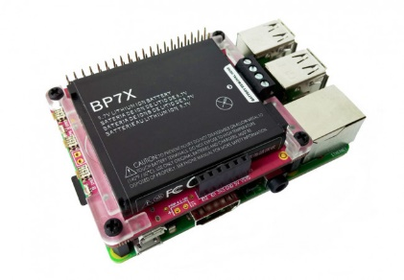
EXCALIBUR – INVESTIGATIVE INFECTION CHAIN ANALYSIS AND RESPONSE Achievements And Implementation State
Current Status of Architecture and Test Implementation:
Test implementation on technology components since January 2020
Decentralized solution with no data transmission to a centralized data center or cloud
International architectural review since February 2020
Global response with dedicated hardware (Gum Stick) designed starting 01.02.2020
Continuous testing and evaluation of architecture
Adding partner network to identify complexity of implementation using existing hardware (smartphones) of different vendors
3 months internal funding

Slide 18
EXCALIBUR – INVESTIGATIVE INFECTION CHAIN ANALYSIS AND RESPONSE Outlook And Next Steps
Seeking governmental support to accelerate progress
Funding
Scaling and partnering needed
Start of Multi-Project-Management to orchestrate activities such as:
App-development and test implementations on devices of different vendors
Data analysis, e.g. recursion of 1st-level and 2nd-level contact, individual risk analysis based on personal data
Simulation to anticipate scaling up to 80 million users in Germany and billions of users globally
Partnering with EMS (Electronic Manufacturing Services) Companies to progress dedicated devices (The Gum Stick).
Partnering with international organizations to ensure long-term interoperability

Slide 19
Thank You!
MBA B.Eng. Lars Holger Engelhard
covid19-tech-response@unleash-future.com
UNLEASH FUTURE®
www.unleash-future.com

